Slide 1
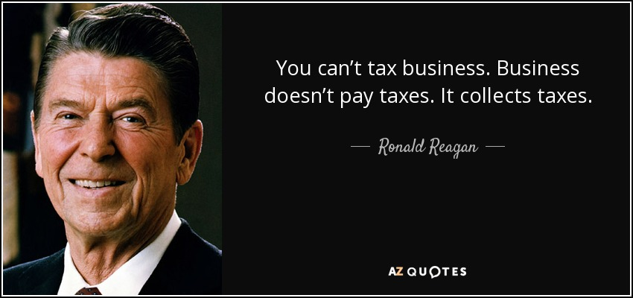

Slide 2
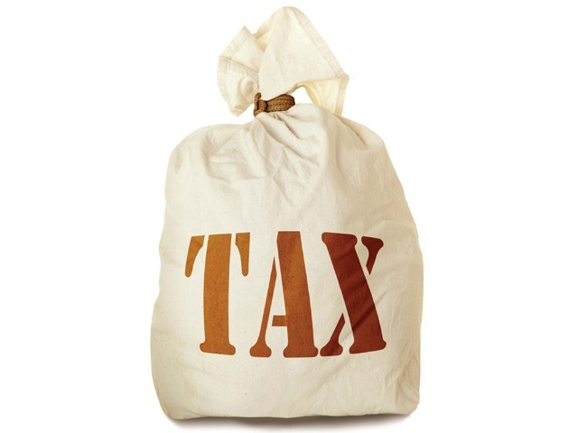
Levy and Collection of GST
- Krishnan R, SIES College, Sion (W)

Slide 3
Provisions of CGST and IGST Act
Particulars | CGST | IGST
Levied on | Intra State supplies | Inter State supplies
Collected and Paid by | Taxable Person | Taxable Person
Value of Levy | Transaction Value | Transaction Vale
Reverse Charge applicable on | Notified supplies Taxable supplies by an unregistered person to a registered person. | Notified supplies Taxable supplies by an unregistered person to a registered person.
Import of goods | No CGST or SGST/UTGST payable | IGST shall be levied over and above basic customs
Rate of Tax | Cannot exceed 20% | Cannot exceed 40%

Slide 4
Taxable Person
Supplier
Recipient
Notified supplies u/s 9(3)
Supplies by an Unregistered Person
E-Commerce Operator

Slide 5
Rate of Tax
Rate | Particulars | IGST | CGST | SGST/UTGST | CGST + SGST/UTGST
0% | Consumer Basket Goods | - | - | - | -
5% | Mass Consumption Items | 5% | 2.5% | 2.5% | 5%
12% | Processed Food Products | 12% | 6% | 6% | 12%
18% | General Goods and services | 18% | 9% | 9% | 18%
28% | Demerit and Luxury Goods | 28% | 14% | 14% | 28%
0.25% | Rough Diamonds | 0.25% | 0.125% | 0.125% | 0.25%
3% | Gold, precious stones and imitation jewellery | 3% | 1.5% | 1.5% | 3%

Slide 6
A glimpse on goods and services and their tax rates
NIL Tax Rate
Goods
Deities made of stone, marbles or woods, Rakhis, fruits, vegetables, bangles, besan, eggs, newspapers, broom materials, saal leaves, natural honey, bread, salt, bindi, plates and cups made of flower, Sanitary Napkins, leaves and barks etc .
Services
Hotels and lodges with tariff below Rs. 1,000
5% Tax Rate
Goods
Skimmed milk powder, frozen vegetables, coffee, coal, tea, spices, kerosene, ayurvedic medicines, agarbatti, insulin, namkeen, ethanol, handmade braids and carpets, wet grinders, Marine Fuel (HELP), Marine Engine, Electric vehicles and chargers, Walking Sticks, Accessories for Handicapped Mobility Vehicles,
Services
Restaurants, Take away food, transport services like railways and airways, selling of space for print media advertisements, etc.

Slide 7
12% Tax Rate
Goods
Frozen meat products, butter, cheese, ghee, pickles, fruit juices, tooth powder, medicines, umbrella, instant masalas, cell phone, sewing machine, handbags, wooden frames for painting, kerosene pressure stove, nuts, dates, animal fats, pasta, jams, drinking water packed in 20 ltrs bottle, soya milk, milk beverages, etc.
Services
Hotels and lodges with tariff between Rs. 1,001 and Rs. 7,500, works contract, business class air tickets, etc.
18% Tax Rate
Goods
Refines sugar, detergents, compressors, fans, light fittings, chewing gum, hair shampoo, wrist watches, cookers, binoculars, telescope, artificial flowers, musical instruments and their parts, stationery items, electrical boards, razor, furniture, mattress, door, window, etc.
Services
Restaurants inside Hotel with tariff over Rs. 7,500, outdoor catering, IT and Telecom services, Financial Services.

Slide 8
28% Tax Rate
Goods
Pan Masala, sunscreen, weighing machine, cement, automobiles, motocycles, caffeinated beverages, cigarettes, granite, dish-washer, air-conditioner, engine parts, monitors and projectors, etc .
Services
Gambling, entertainment and amusement facility, water parks, joy rides, race course, sport events, etc.

Slide 9
Reverse Charge Mechanism (Goods)
GST will be paid by the recipient under following circumstances:
Note: Agriculturist can be an individual or HUF by own labour, family labour or waged servants.
Sr. No | Nature of supply | Supplier of goods | Recipient of goods (Liable to pay tax)
1 | Un-peeled/un-shelled cashew nuts | Agriculturist | Any registered person
2 | Bidi wrapper leaves | Agriculturist | Any registered person
3 | Tobacco leaves | Agriculturist | Any registered person
4 | Silk yarn | Silk yarn manufacturer out of raw silk/silkworms for its supply | Any registered person
5 | Supply of lottery | State Govt / UT / LA | Lottery distributor/selling agent
6 | Used vehicles, seized goods, old and used goods and scrap | CG / SG / UT / LA | Any registered person
7 | Raw Cotton | Agriculturist | Any registered person

Slide 10
Reverse Charge Mechanism (Services)
GST will be paid by the recipient under following circumstances:
Sr. No | Nature of supply | Supplier of service | Recipient of service (Liable to pay tax)
1 | Transportation of goods by GTA through road to factory, society, registered person, body corporate, firm or casual taxable person | Goods Transportation Agency (GTA) | Any factory, society, registered person, body corporate, firm or casual taxable person
2 | Legal services provided by an individual/senior advocate or firm of advocates | An individual/senior advocate or firm of advocates | Any business entity located in taxable territory who is litigant, applicant or petitioner
3 | Services by an arbitrary tribunal to a business entity | Arbitrary tribunal | Any business entity located in taxable territory
4 | Services provided by way of sponsorship to any body corporate or partnership firm | Any person | Any body corporate or partnership firm located in taxable territory

Slide 11
5 | Services provided by CG, SG, UT or LA to a business entity except Renting of immovable property Services by dept of post (speed post, express parcel post, life insurance and agency services provided to a person other than CG, SG, UT or LA Services in relation to an aircraft/vessel, inside/outside of a port/airport Transport of goods or passengers | CG, SG, UT or LA | Any business entity located in taxable territory
5A | Services provided by CG, SG, UT or LA by way of renting of immovable property to a person registered under CGST Act 2017 | CG, SG, UT or LA | Any person registered under CGST Act 2017
6 | Services by a Director of Company or a Body Corporate to the said Company or the Body Corporate | A Director of a Company or a Body Corporate | The Company or a Body Corporate located in the taxable territory

Slide 12
7 | Services by an Insurance Agent to any person carrying insurance business | Insurance Agent | Any person carrying insurance business located in taxable territory
8 | Services by a recovery agent to a Banking Company or a Financial Institution or an NBFC | Recovery Agent | Banking Company or a Financial Institution or an NBFC located in taxable territory
9 | Supply of services by an author, music composer, photographer, artist or by way of transferring or permitting the use if enjoyment of a copyright relating original work to a publisher, music company or producer | Author, music composer, photographer or artist | Publisher, music company, producer located in taxable territory
10 | Supply of services by the members of Overseeing Committee to RBI | Members of Overseeing Committee constituted by RBI | RBI

Slide 13
Notified Services under IGST
Sr. No. | Nature of Supply | Supplier | Recipient (Liable to pay tax)
1 | Services supplied by a person located in a non-taxable territory to any person other than non-taxable online recipient. | Any person located in non-taxable territory | Any person located in taxable territory except non-taxable online recipient
2 | Services supplied by a person located in non-taxable territory by way of goods transportation through a vessel from outside India up to Customs station of clearance in India | Any person located in non-taxable territory | Importer located in taxable territory
Non-taxable online recipient means govt, local authority, individual or any unregistered person receiving online information and database access related to anything except commerce, industry or any business profession, located in taxable territory.

Slide 14
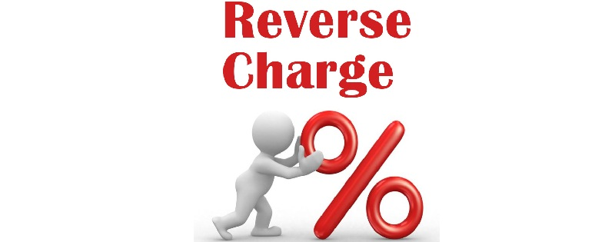
Supply from URD [Sec 9(4)]
Deferred to 30th Sept, 2019
This provision will apply if the below conditions are met:
There should be a supply of goods or services
The supply should be in respect of taxable goods/services
Supply must be by an unregistered person.
Supply must be to a registered person
Supply must be an intra-state supply as compulsory registration is required for inter-state sales
Purchases up to Rs. 5,000 per day from unregistered suppliers will not attract GST. In other words, there is a reverse charge on buying from unregistered dealers if you are dealing with unregistered suppliers and making payments above Rs. 5,000.

Slide 15

Profit & Loss A/c items which might attract GST under RCM in relation to URD?
Rent, Commission payments, Printing and stationery, Repairs and Maintenance, Office Maintenance, Vehicle maintenance, Computer maintenance, Legal Fees, Consultancy Fees, Professional Fees, Audit Fees, Freight and transportation expenses (GTA), Gift expenses, Business promotion expenses, Advertisement, etc.
Exceptions
For these items, RCM will not apply for the simple reason that GST is not applicable on these:
Salary and wages, Electricity, Interest, Car fuel (Diesel/petrol), Government Fees (such as MCA fees, land registration fees etc.)
“RCM will not be applicable on exempted goods”

Slide 16

Electronic Commerce Operator [Sec 9(5)]
ECO: Display products or services which are actually supplied by some other person to the consumer. The ECO provides a market place for selling dealer’s goods. The ECO collects amount from the consumer and remits to the dealer.
Radio Taxi: Taxi services having two way communication with a Central Control Office Taxi operating using GPS or GPRS.
Maxicab / Motorcab / Motor Car: 6-12 passengers / up to 6 passengers / any motor vehicle other than transport vehicle, omnibus, road-roller, tractor, motor-cycle or invalid carriage.

Slide 17


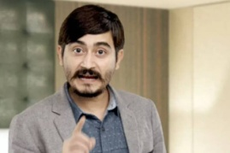
Sr. No. | Nature of Service | Supplier | Recipient | Person Liable to pay GST
1 | Services by way of transportation of passengers by a radio taxi, motor cab, maxi cab or motor cycle | Driver | Any person | ECO (OLA, UBER)
2 | Services by way of providing accommodation in hotels, inns, guest houses, clubs, campsites or other commercial places meant for residential or lodging purposes, except where the supplier of such service is liable for registration under GST | Unregistered person supplying services through ECO | Any person | ECO (MMT, GOIBIBO, AIRBNB, TRIVAGO)

Slide 18
IMPORTS | EXPORTS
Bringing goods from a foreign nation to India | Taking goods out of India to a place outside India
IGST will be levied as ACD. Taxed at the Customs Frontiers of India like Customs Port, Customs Airport, International Courier Terminal, Foreign Post Office, Bonded Warehouse, etc where goods are kept for clearance. IGST on import of services shall be paid by the recipient in India under RCM. | Exports of goods and services are treated as ZERO RATED SUPPLY. ITC can be availed for making ZRS, even if its an exempted supply. The exporter can claim refund under Supply of goods under bond or LUT without payment of IGST and claim refund of unutilized amount of ITC. Supply goods on payment of IGST and claim refund of IGST

Slide 19
Composition Scheme [Sec. 10]
An optional scheme for certain dealers to have a hassle free tax compliance.
Suitable for small taxpayers having lower economies of scale.
The dealer need to pay a certain amount of fixed rate of tax on his annual turnover on quarterly basis.
The tax paid is a cost to the dealer.
The dealer cannot issue tax invoice.
The dealer cannot claim any ITC.
The dealer cannot supply GST exempted goods.
Different segments like textiles, electronics , groceries, etc. under the same PAN must registered collectively under the scheme.
The dealer has to mention “Composition Taxable Person / Composition Scheme on a signboard at their place of business.
A manufacturer or trader can now also supply services to an extent of ten percent of turnover, or Rs.5 lakhs, whichever is higher. This amendment is applicable from the 1st of Feb, 2019.

Slide 20
Turnover Limits | An Aggregate Turnover of Rs. 1.5 Crore (w.e.f 1st April, 2019) for goods. Rs. 50 Lakhs for services. Rs. 75 Lakhs for Special Category States except Uttarakhand and JK (Aggregate T/O includes taxable, exempt, export and inter-state supplies between distinct person with same PAN but excludes I/W supplies under RCM and CGST, SGST, UTGST, IGST and CESS.)
Turnover Computation | Turnover of all business with same PAN shall be considered for calculating turnover.
Person who cannot opt (Notified) | Interstate supply of goods and services. Manufacturer of Ice Cream, Pan Masala or Tobacco. Casual Taxable Person or a Non-Resident Taxable Person. Business supplying goods and services through an ECO.
Transaction Evidence | Bill of Supply with a mentioning of “ Composition Taxable Person” and not Tax Invoice
GST Payment | GST Payment includes: GST on supplies GST on RCM GST on purchase from URD
Return Filing | Quarterly Returns (GSTR – 4) to be filed by 18th day of the next month. Annual Returns (GSTR – 9A) to be filed by 31st Dec of the next FY.

Slide 21
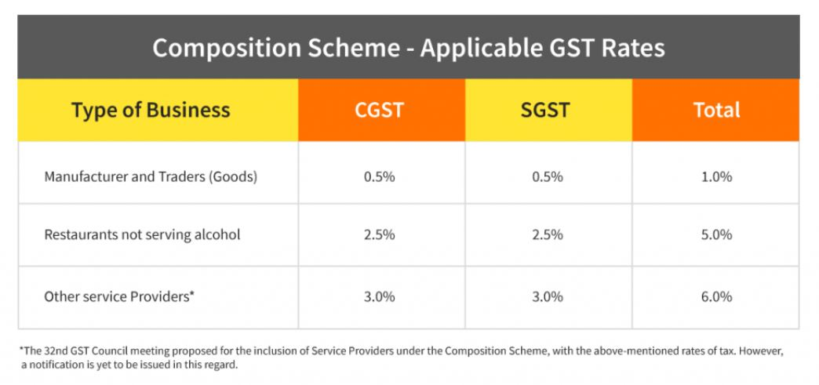
Note: The above rates are on Turnover in State / Union Territory

Slide 22
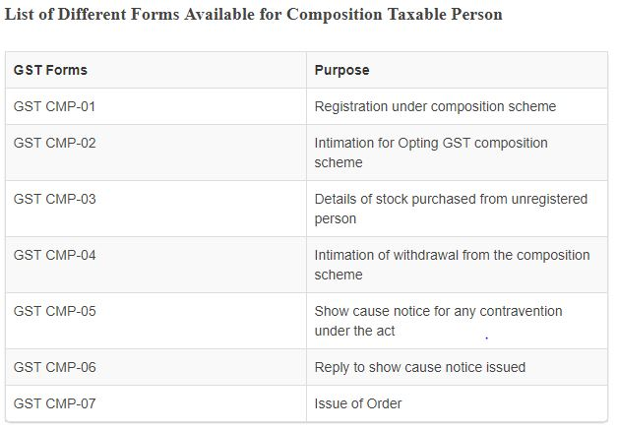

Slide 23
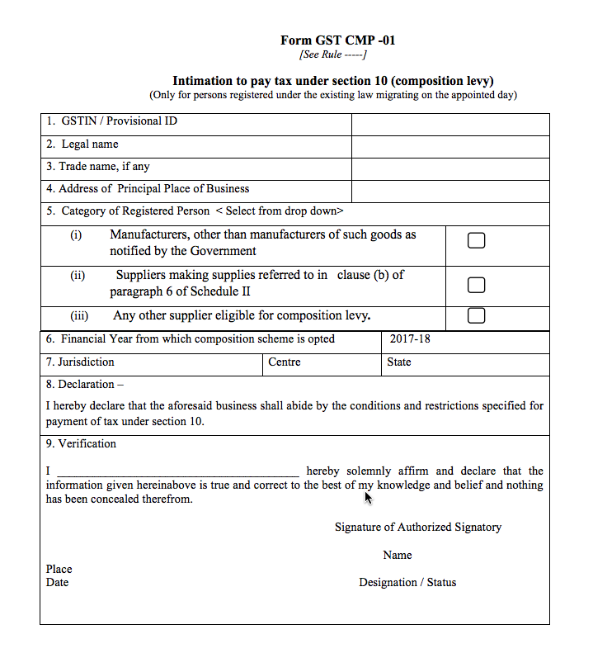

Slide 24
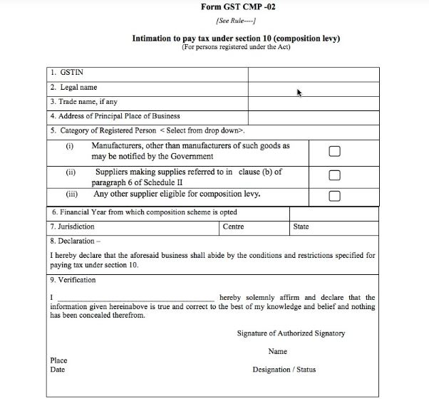

Slide 25
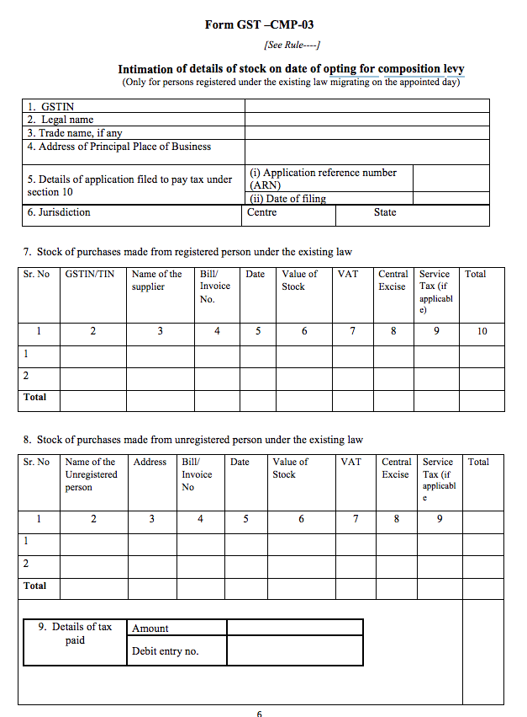

Slide 26
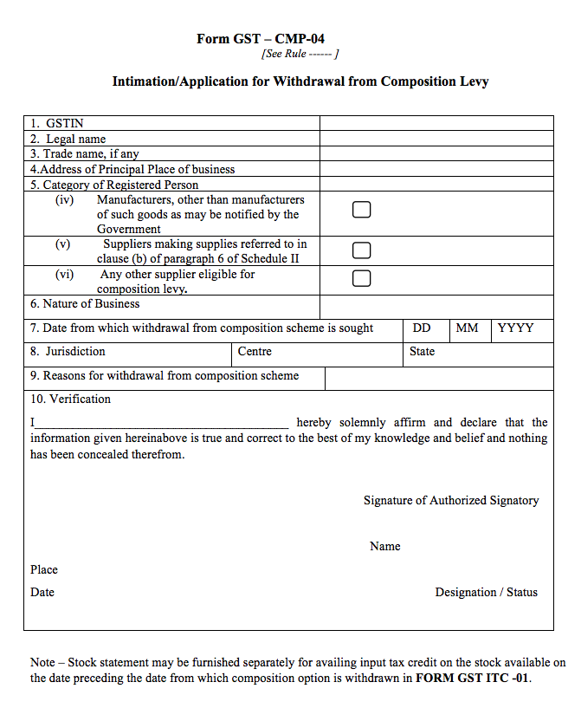

Slide 27
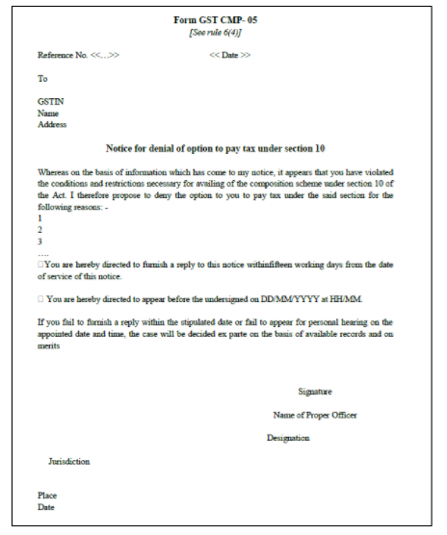

Slide 28
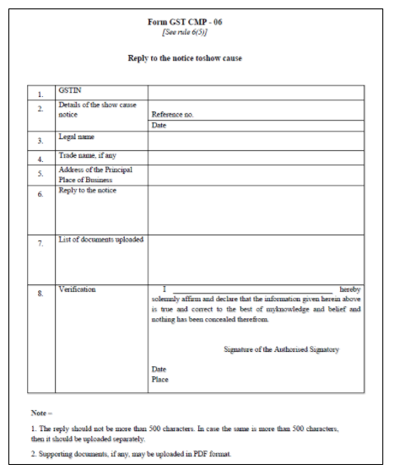

Slide 29
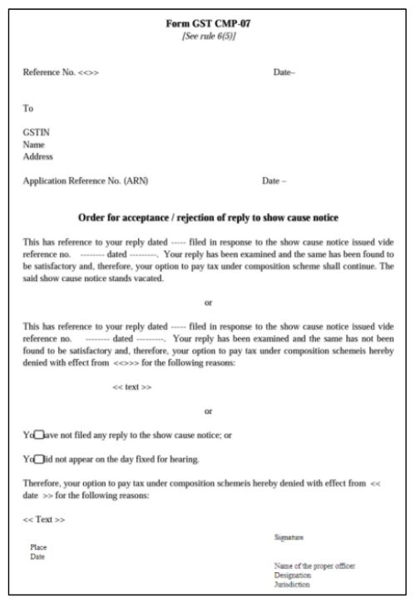

Slide 30
Mandal Aabhari Aahe

